Slide 1
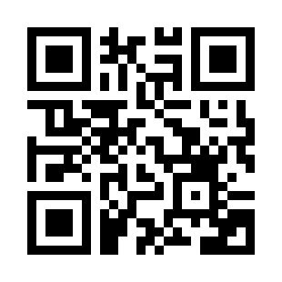


Introduction to JavaScript Quiz
https://bit.ly/3stG0t6

